Slide 1


St. MARTINS ENGINEERING COLLEGE
UGC Autonomous
NBA & NAAC A+ ACCREDITED
Dhulapally, Secunderabad– 500100
Department of Computer Science And Engineering(AI&ML)
Facial Expression Recognition Dataset: A Comprehensive Resource for Emotion Analysis and AI Development
Batch No: CSM05
1. T.AKSHITHA (21K81A6655)
2. K.GAYATHRI (21K81A6623)
3. O.PRASHANTH (21K81A6635)
Under the Guidance of
Mr. KRANTHI KUMAR
ASST.PROFESSER
Department of CSE(AI&ML)

Slide 2
OUTLINE
Abstract
Introduction
Literature Survey
Existing System
Proposed System
Modules (Split –up)
Flow diagrams
Algorithms/Techniques
Implementation of 30% code
References

Slide 3
ABSTRACT
Facial emotion analysis has gained significant interest in recent years due to its applications in various fields, including human-computer interaction, security, and psychological studies
These statistics underscore the importance of developing robust and reliable facial emotion analysis systems. Existing manual approaches to facial emotion analysis involve human observers interpreting facial expressions.
These methods are time-consuming and lack consistency, as different observers may interpret the same expression differently. Moreover, manual analysis is not scalable for large datasets or real-time applications.
The inherent biases and limitations of human observers highlight the need for more objective and scalable solutions to facial emotion analysis.
Machine learning (ML) presents a promising solution to the challenges faced by manual approaches. By training models on large datasets of facial expressions

Slide 4
INTRODUCTION
Facial recognition and detection are cutting-edge technologies revolutionizing how we interact with digital and physical environments .By analyzing and identifying unique facial features, these technologies enable automated identification, authentication, and surveillance in various applications.
These technologies utilize advanced algorithms to detect and analyze facial characteristics such as the distance between eyes, nose shape, and jawline structure.
Initially developed for security and law enforcement purposes, facial recognition has expanded into diverse fields including mobile devices, retail, and healthcare.
The process typically involves capturing facial images or video frames, extracting unique features, and matching them against a database of known faces.

Slide 5
INTRODUCTION
Applications range from unlocking smartphones and automated passport control to monitoring attendance and enhancing customer experiences in retail.
Challenges include accuracy under varying lighting conditions, pose variations, facial expressions, and potential biases in datasets used for training.
Advances in computer vision and artificial intelligence have accelerated the accuracy and adoption of facial recognition systems in recent years.
Facial recognition is poised to revolutionize industries by streamlining processes, enhancing security measures, and personalizing user experiences.
The technology's rapid evolution raises questions about data security, algorithmic transparency, and societal implications.

Slide 6
LITERATURE SURVEY
S. No | Author | Title | Year | Contributions
01 | ALEJANDRO GOMEZ | Emotion recognition and facial expression | 2024 | Convolutional Neural Networks
02 | DIVYA TYAGI | Facial expression recognition using hybrid approach | 2024 | Support Vector Machine CLASSIFER
03 | INDRAJANI SUTEDJA | Emotional expression Recognition | 2023 | Systematic literature review Using suited algorithms
04 | SUBHAM SHAH | Audio based facial expression | 2023 | Argumented reality technology
05 | DEEPAK RAJ | Facial expression recognition using CNN | 2023 | Image preprocessing features

Slide 7
EXISTING SYSTEM
CONVOLUTIONAL NEURAL NETWORK(CNNs):
Utilized for extracting features from facial images, CNNs are highly effective in recognizing and classifying emotions.
EMOTION RECOGNIZATION DATASETS:
Affect Net: A diverse dataset with over a million facial images labeled with seven different emotion categories, providing a rich resource for training deep learning mode
Emo React: A dataset that includes facial expressions along with contextual information, providing a richer understanding of emotions in various scenario
ENHANCED HYBRID MODEL:
Multisensory Emotion Recognition:
These models combine facial expression data with other inputs such as voice, body language, and physiological signals to enhance the accuracy of emotion recognition.

Slide 8
PROPOSED SYSTEM
FACE EMOTION EXPRESSION DATABASE:
A face emotion expression database is a collection of images or video clips with facial expressions of a range of emotions. These databases are essential for training, testing, and validation of algorithms
IMAGE PREPROCESSING:
Image preprocessing is a crucial step in computer vision and image analysis. It involves modifying the images to prepare them for further processing or analysis.
AI MODEL TRAINING:
To train an AI model for face emotion expression recognition, you can use a deep learning approach, specifically Convolutional Neural Networks (CNNs).

Slide 9
PERFORMANCE ESTIMATION:
Performance estimation is a crucial step in evaluating the effectiveness of a machine learning model. Here are some common metrics used to estimate the performance of a face emotion expression recognition model: precision and accuracy.
TEST FACIAL EXPRESSION:
To test facial expressions, you can use various databases and tools. There are several face emotion expression databases available, such as the NimStim set of facial expressions, FACES stimulus set
OUTPUT FACE EMOTION:
You can use a CNN model trained using Keras to output face emotion.
.

Slide 10
Face Emotion
Expression Dataset
Image Preprocessing
MODULE SPLIT UP
AI Model Training
Performance Estimation
Test Facial Expression

Slide 11
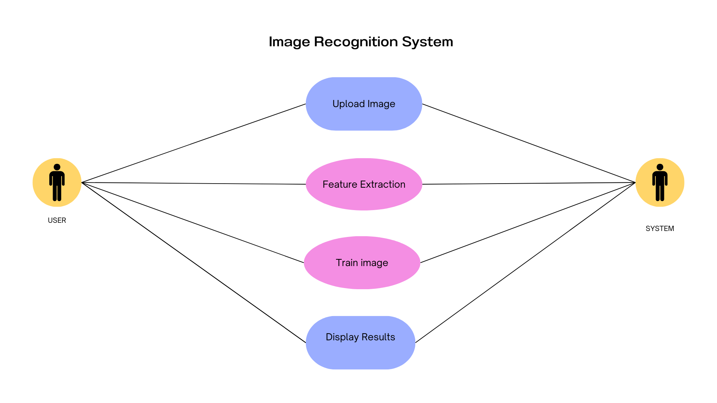
USE CASE DIAGRAM

Slide 12
Data Splitting
Image Preprocessing
ML Model
Building
Upload Dataset
Flow Chart Diagram
CNN &DTC
Algorithms
Outcome
Performance
Evaluation
Model Testing

Slide 13
ALGORITHMS
Convolutional Neural Networks (CNN){90%}
CNNs are used to scan images and detect faces by identifying patterns and features (like eyes, nose, and mouth). They excel in spatial hierarchies, meaning they can understand images at multiple levels (from edges to complex structures like faces)
CNN architectures, like YOLO (You Only Look Once) or Faster R-CNN, are often used for real-time face detection. These models can locate faces in an image and draw bounding boxes around them.
Decision Tree Classifiers (DTC){86%}
After a CNN detects and recognizes faces, the results can be further refined using a DTC. For example, if the CNN outputs several possible identities for a face, a DTC could be used to make a final decision based on additional features or metadata (like time of day, location, etc.).
In some cases, instead of using raw pixel data, features extracted from faces (e.g., eye distance, nose shape) can be used as inputs to a DTC to classify the faces into known identities.

Slide 14
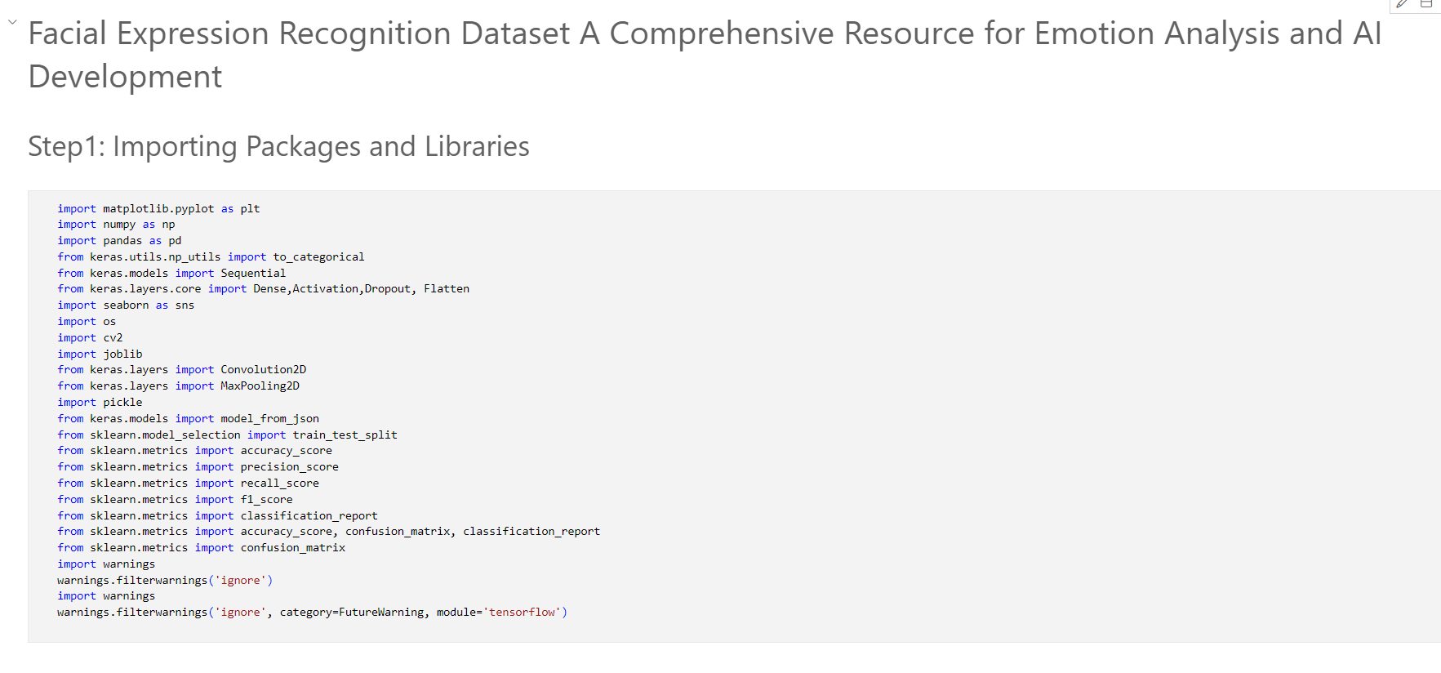
IMPLEMENTATION

Slide 15
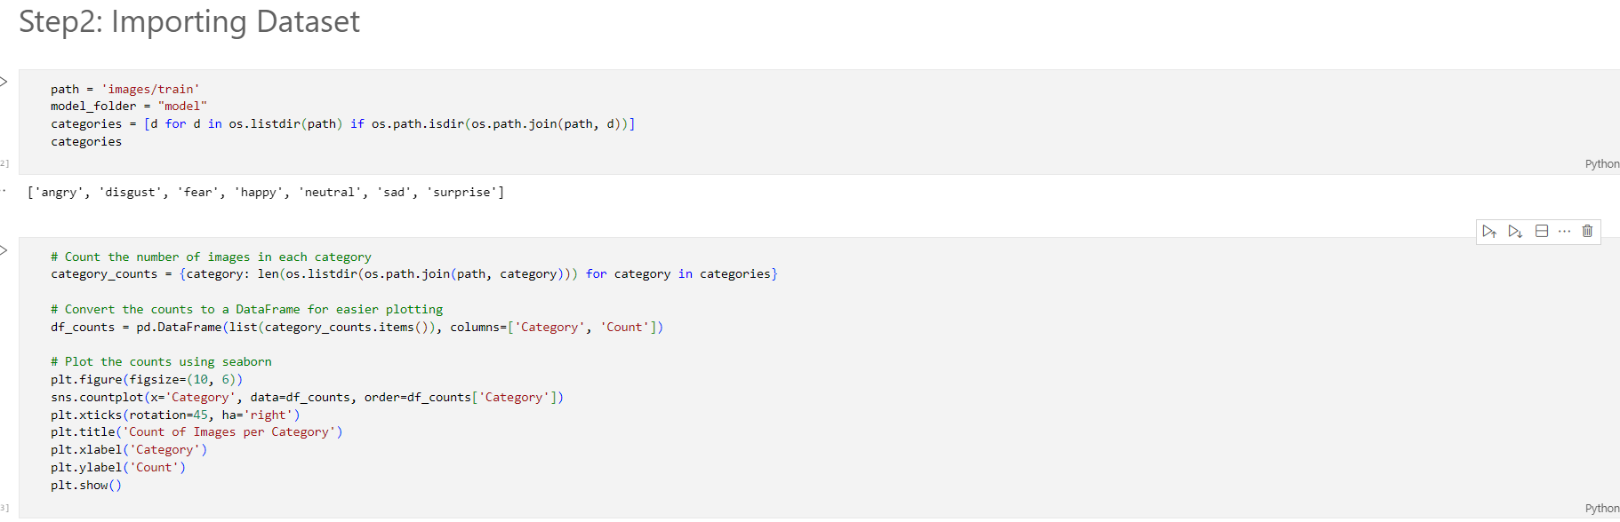
IMPLEMENTATION

Slide 16
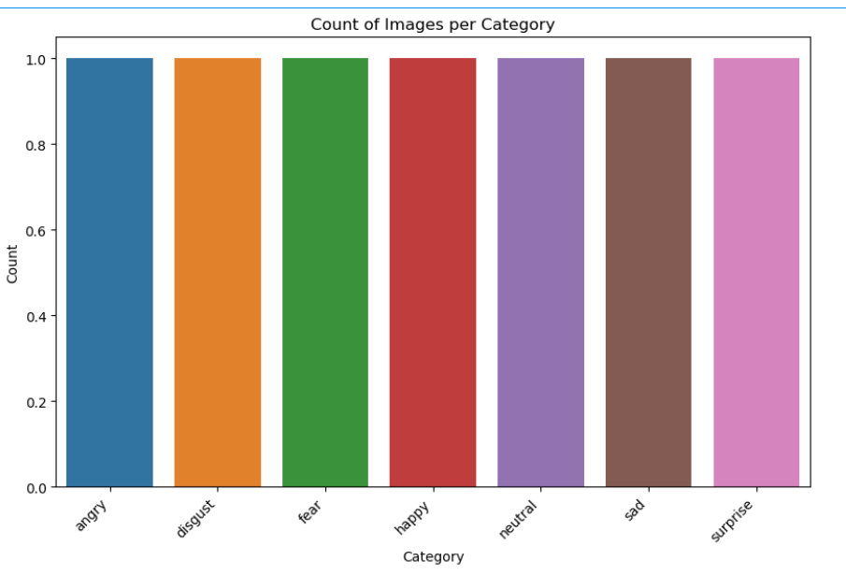
IMPLEMENTATION

Slide 17
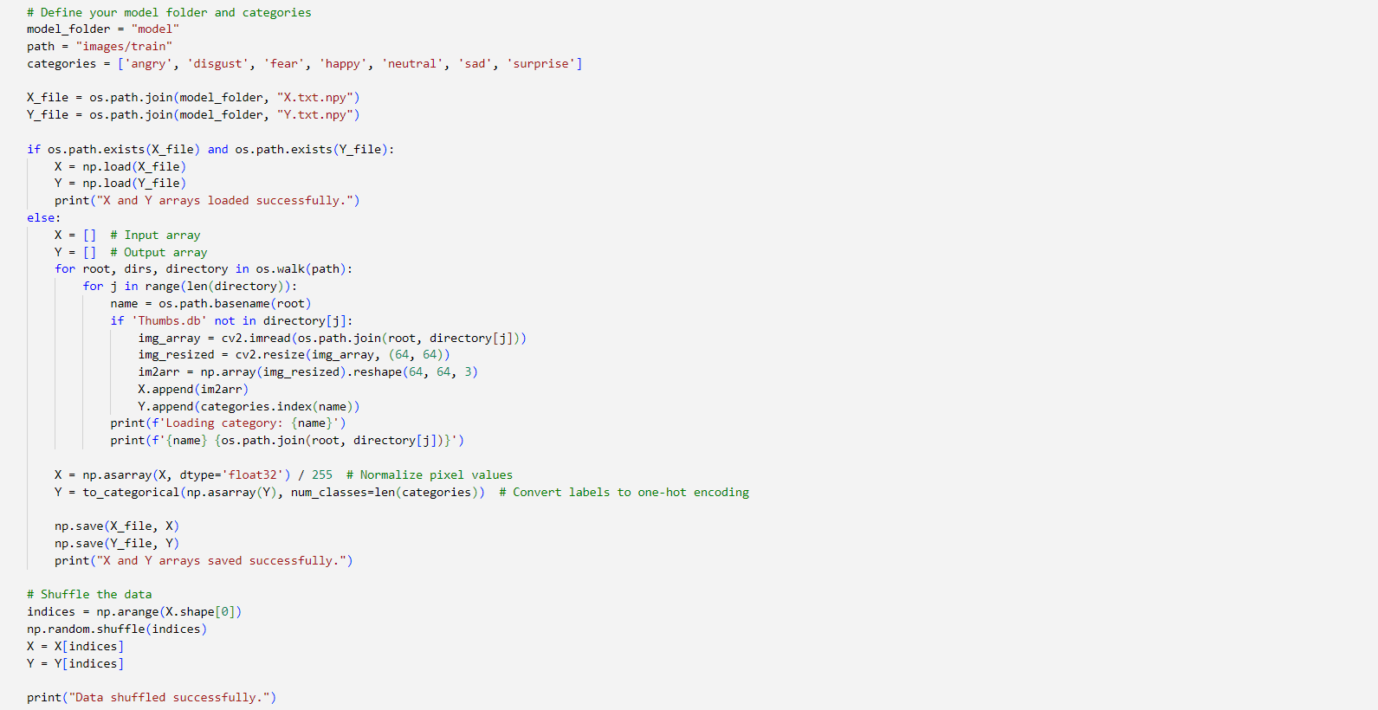
IMPLEMENTATION

Slide 18
REFERENCES
FER-2013: A Large-Scale Dataset for Facial Emotion Recognition" by J. M. A. De la Torre, T. Zhang, and others (2013)
"Emotion Recognition from Facial Expressions using Deep Learning Techniques" by J. A. Gonzalez, M. S. Gupta, and others (2021)
DeepFace: Closing the Gap to Human-Level Performance in Face Verification" by Yaniv Taigman, Ming Yang, and others (2014)
"Facial Expression Recognition Using Deep Learning" by Y. Liu, M. M. K. Naidu, and others (2019)
A Survey on Facial Emotion Recognition with Deep Learning" by Zhiwei Zhang, Yunchao Wei, and others (2020).

Slide 19
REFERENCES
Mateusz Zarkowski Identification-deiven Emotion Recognition System for a Social Robot IEEE Posted: 2013Crossref 72.
M Pantic, A Pentland, A Nijholt, TSHuang Human computing and machine understanding of human behaviour: a survey, in Artificial Intelligence for Human Computing Lecture, volume 4451
H K Meena, K K Sharma, S D Joshi Improved facial expression recognition using graph signal processing Electronics
TAhsan, T Jabia, U.-P Chong Facial expression recognition using local transitional pattern on Gabor Filtered facial image

Slide 20
THANK YOU

